Slide 1

Study at UNO!

Slide 2
What is I-O?

Slide 3
What is I-O?
The scientific study of the workplace
Includes
  performance assessment
  training
  personnel selection
  organizational development
  consumer satisfaction
  performance predictors
  work group dynamics
  work-life balance

Slide 4
Where Do We Work?
Professors at Universities
Consultants or Performance Consultants
Employee Effectiveness/Quality Managers
Human Resources Managers
Trainers and Organizational Development Practitioners
Statistical Analysts
Compensation Analysts

Slide 5
Why Study at UNO?
Highly ranked program
  MS program 6th best in US
  One of the top 20 PhD programs in the country
Offer MS and MA/PhD tracks
  MS
    No thesis
    Applied focus
  MA/PhD:
    Thesis required
    Applied or research focus

Slide 6
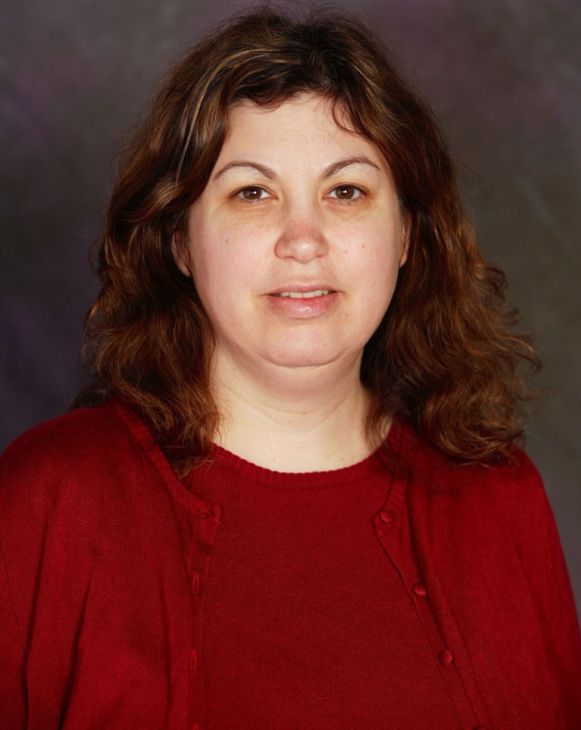
Meet our Faculty
Roni Reiter-Palmon
Research Interests:
  Personality
  Creativity
  Leadership

Slide 7
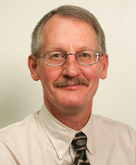
Meet our Faculty
Wayne Harrison
Research Interests
  Workplace Motivation
  Procedural Justice
  Meaningful Work
  Visionary Leadership

Slide 8
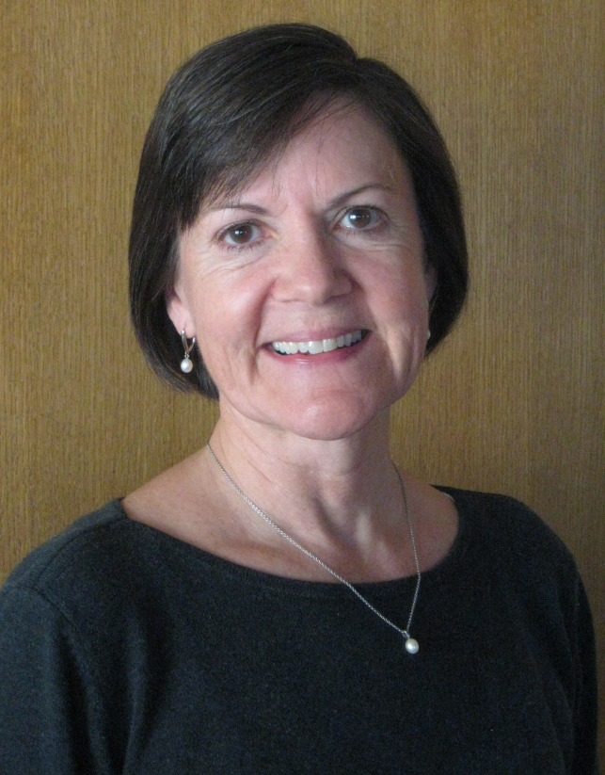
Meet our Faculty
Carey Ryan
Research Interests
  Diversity Issues
  Group Processes
  Intergroup Relations

Slide 9
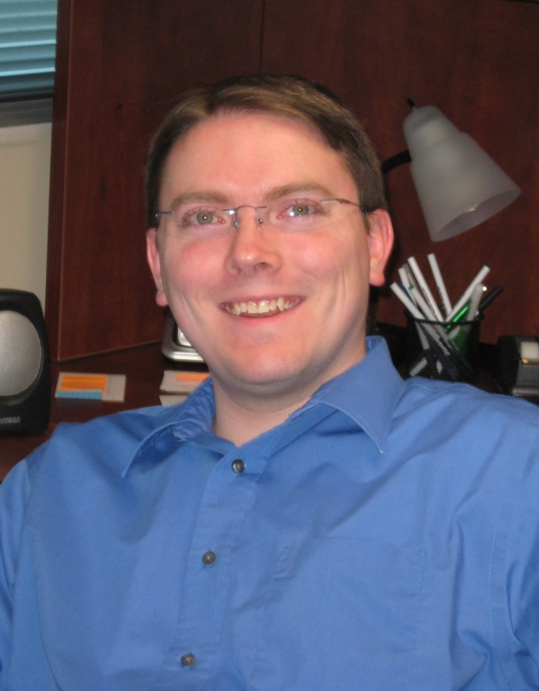
Meet our Faculty
Joseph Allen
Research Interests
  Teams & Meetings
  Stress & Emotions
  Volunteerism

Slide 10
Resources at UNO
New students assigned mentors
  In addition to faculty advisor
Faculty research groups
Teaching and research assistantships available
Paid internships available

Slide 11
Center of Applied Psychological Services (CAPS)
Develop customer experience surveys, interviews, and focus groups
Conduct workflow analysis for a county government
Evaluate effectiveness of leadership development program

